Slide 1

Adventures with Spotify!
davemateer at gmail.com
github.com/djhmateer
Notes:
Excited to be here and talk about my adventures in Spotify.. Thanks for coming!
Slides videos embedded in powerpoint and code on github
Will display links at end too
Ask questions at any time
My name is Dave.. Developer 14 years.
Day job is….

Slide 2








Thanks Quorum (Dave’s employer)
Notes:
45 employees in Qurorum, based in Edinburgh. The kind of clients we work with
I work out of the Brighton office
C sharp, and VB.. SQL

Slide 3

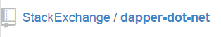
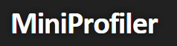

What’s in this talk for Me?
“How to Query a RESTful API using .NET”
C# 4.5 Async Await
Notes:
Interesting technologies

Slide 4
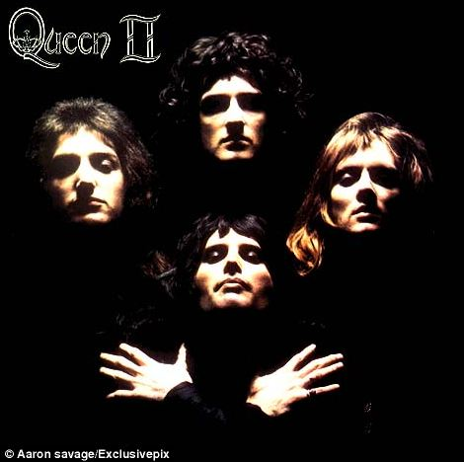
MUSIC!
Notes:
Who I am
What this is about
Why they should care

Slide 5
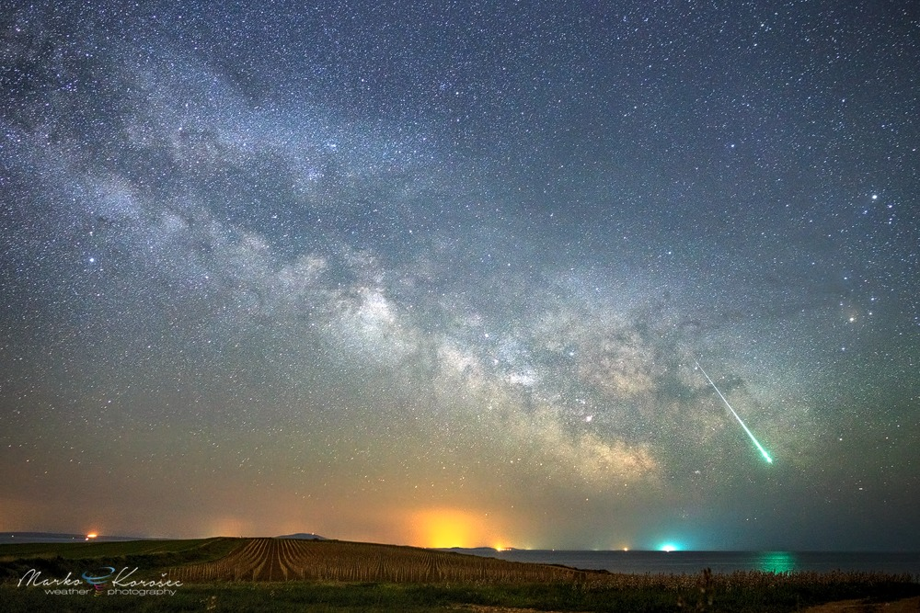






“How to Query a RESTful API using .NET”
Notes:
Google eath data
Astronomy picture of the day

Slide 6
The Problem
"While coding at work I want to listen to great songs and albums that I know"
Notes:
So I was curious about Spotify and I set out to find out more.
Built website, purely for fun, to help me navigate the 38m songs in Spotify.

Slide 7
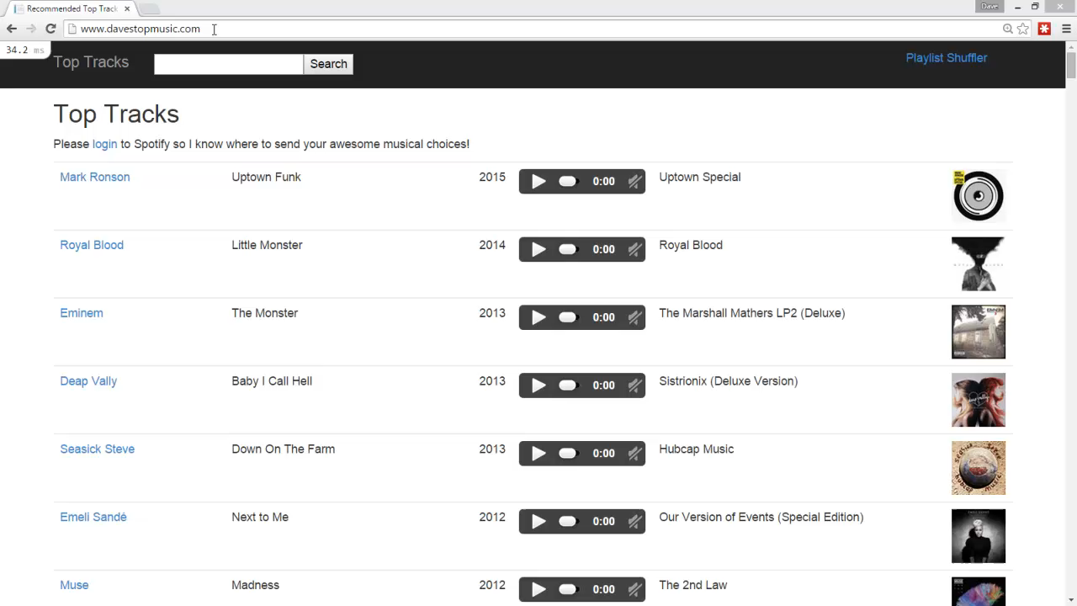

Slide 8
What is Spotify?
Music streaming service
2008, Sweden, 60m (15m paid) Users, 38m tracks

Slide 9
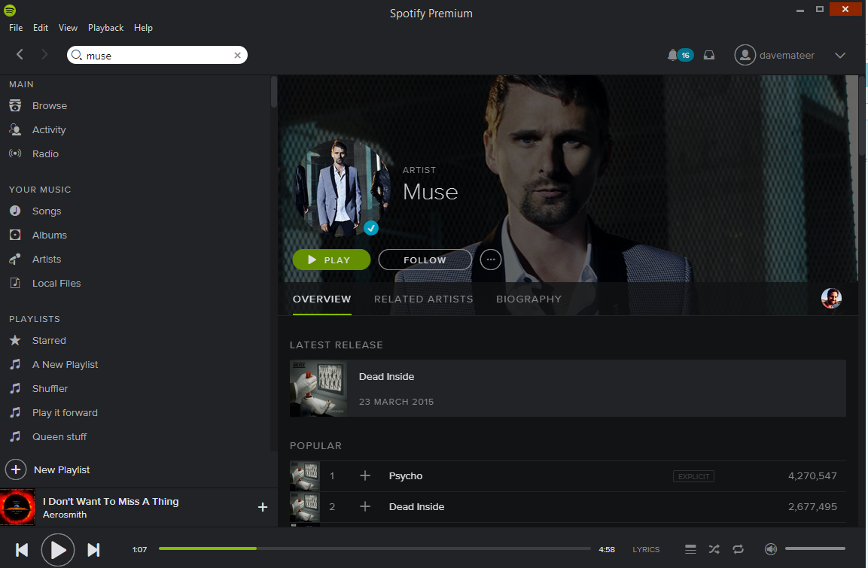
What is Spotify?

Slide 10
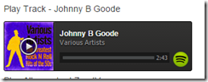
Embed
iframe src="https://embed.spotify.com/?uri=spotify:track:0mDHS1Q7HGtpgjYAyG2Svn">

Slide 11
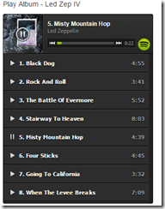
Embed Album / Playlist
iframe src="https://embed.spotify.com/?uri=spotify:user:hoxsd:playlist:0Z7jXtAId643ujM1UPshcte“

Slide 12
There is a Web API to do stuff
Explore Spotify catalogue
Create and add tracks to playlists

Slide 13
Query API via Chrome

Slide 14
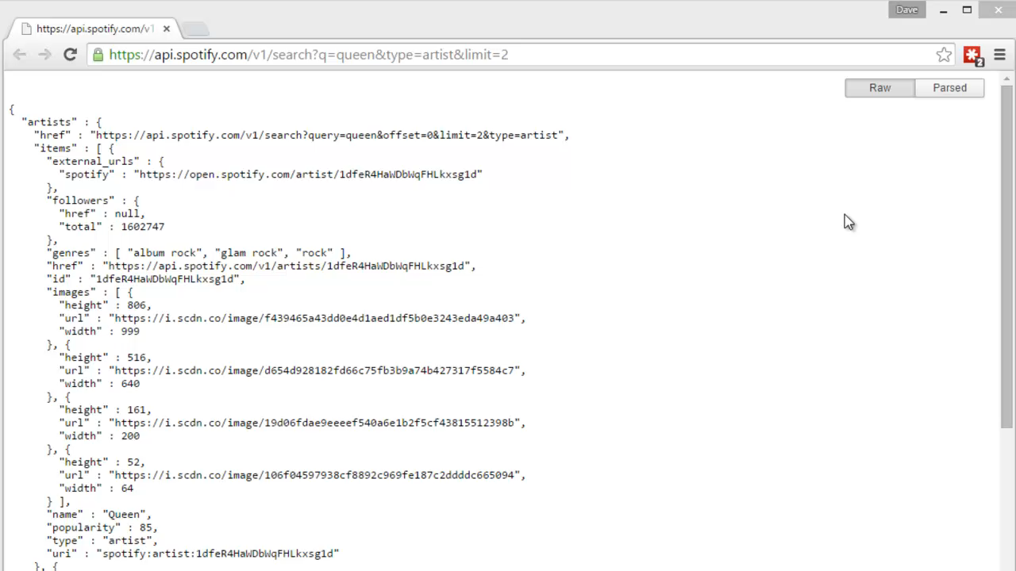

Slide 15
Query API via Console App

Slide 16
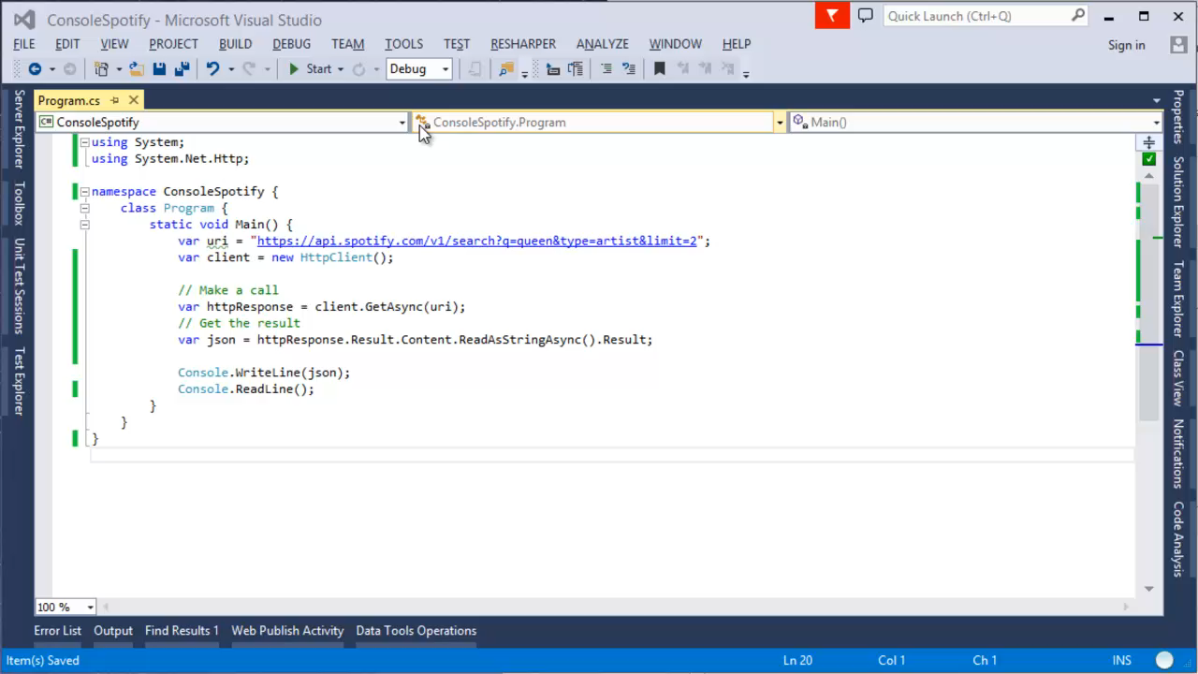
Console App

Slide 17
Deserialise

Slide 18
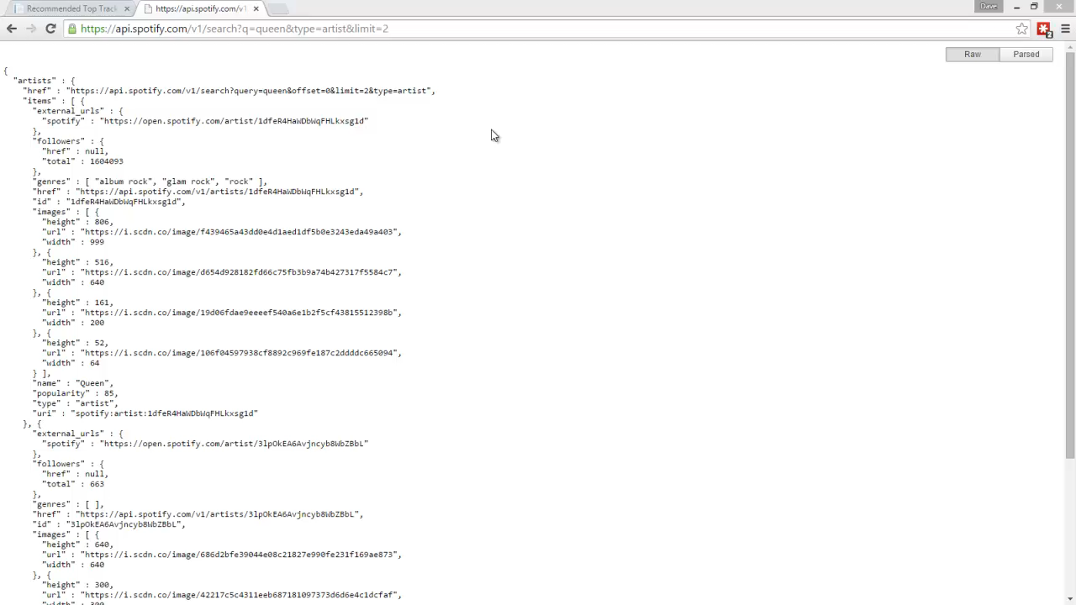
Console App

Slide 19
Website ASP.NET MVC5

Slide 20
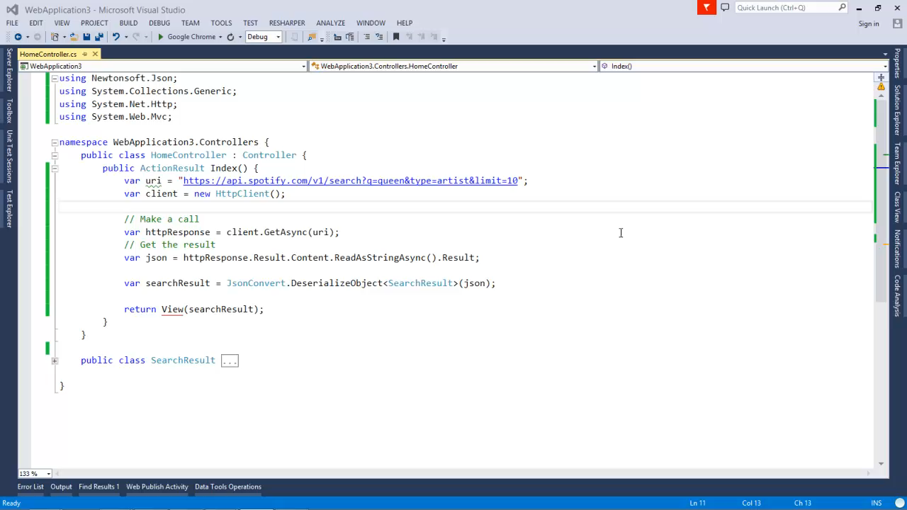
Console App

Slide 21
Http calls to servers
Notes:
GET POST PUT DELETE

Slide 22
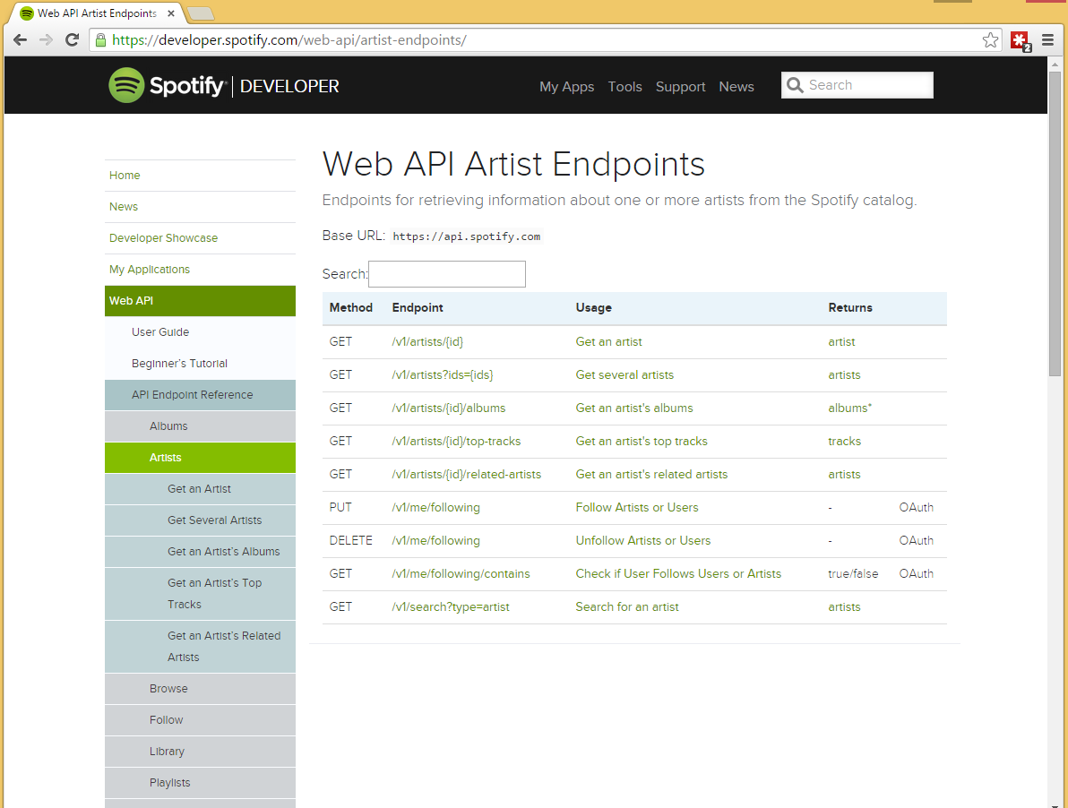
Notes:
GET POST PUT DELETE

Slide 23
Look at internals of the website
Notes:
GET POST PUT DELETE

Slide 24
OAuth2

Slide 25
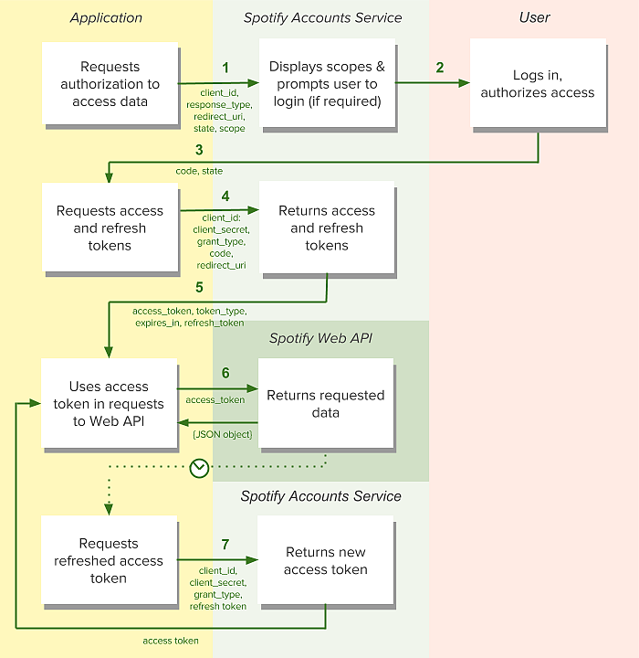

Slide 26
MiniProfiler

Slide 27
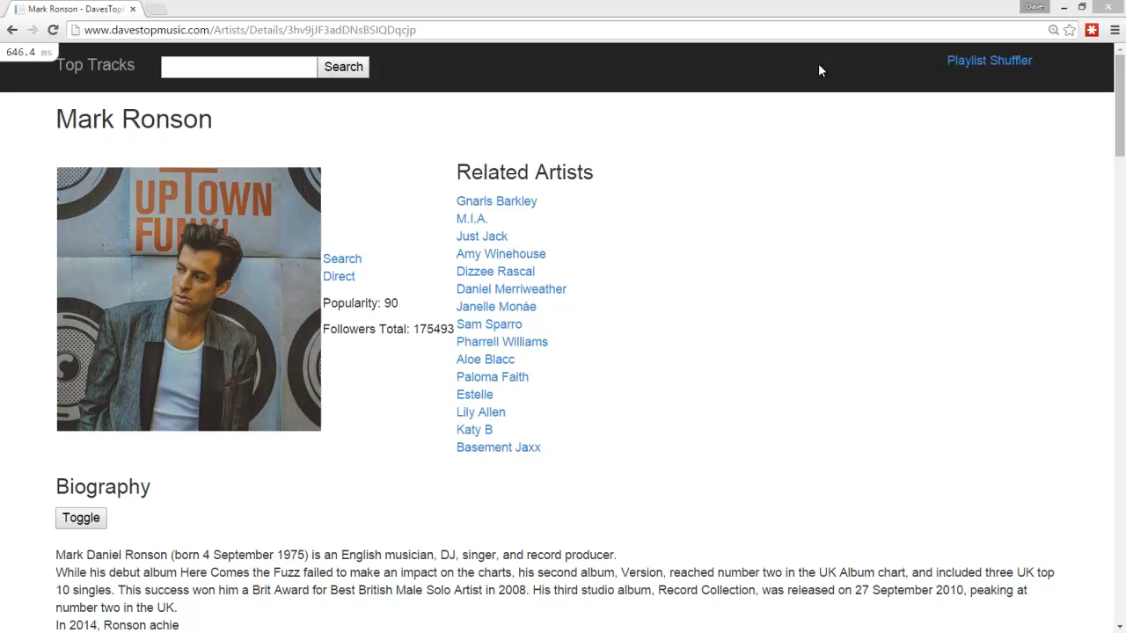
..

Slide 28
Asynchronous
Notes:
Fun – wanted to explore doing things in parallel.
Do simple example of task wait - 5AsyncConsole
Do web example 5 – 5AsyncWeb

Slide 29
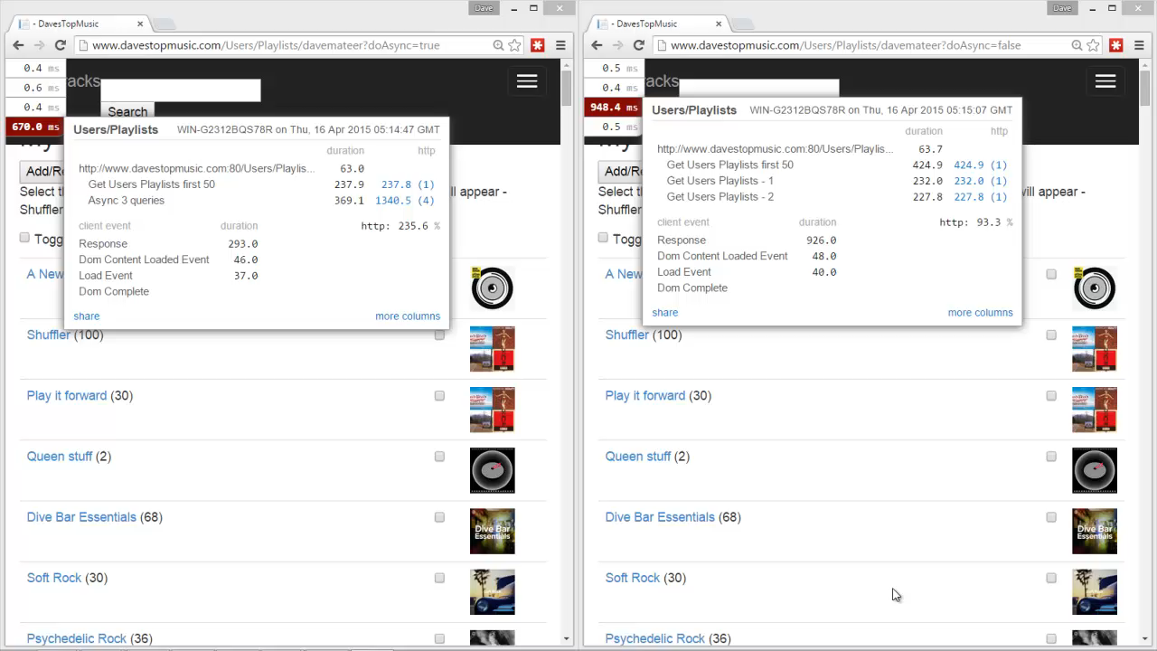
..
Notes:
Get 50 playlists at a time
Have to get the first one synchnously so know how many calls to do async
union at the bottom to aggregate results

Slide 30
Dapper – a Micro Object Relational Mapper

Slide 31
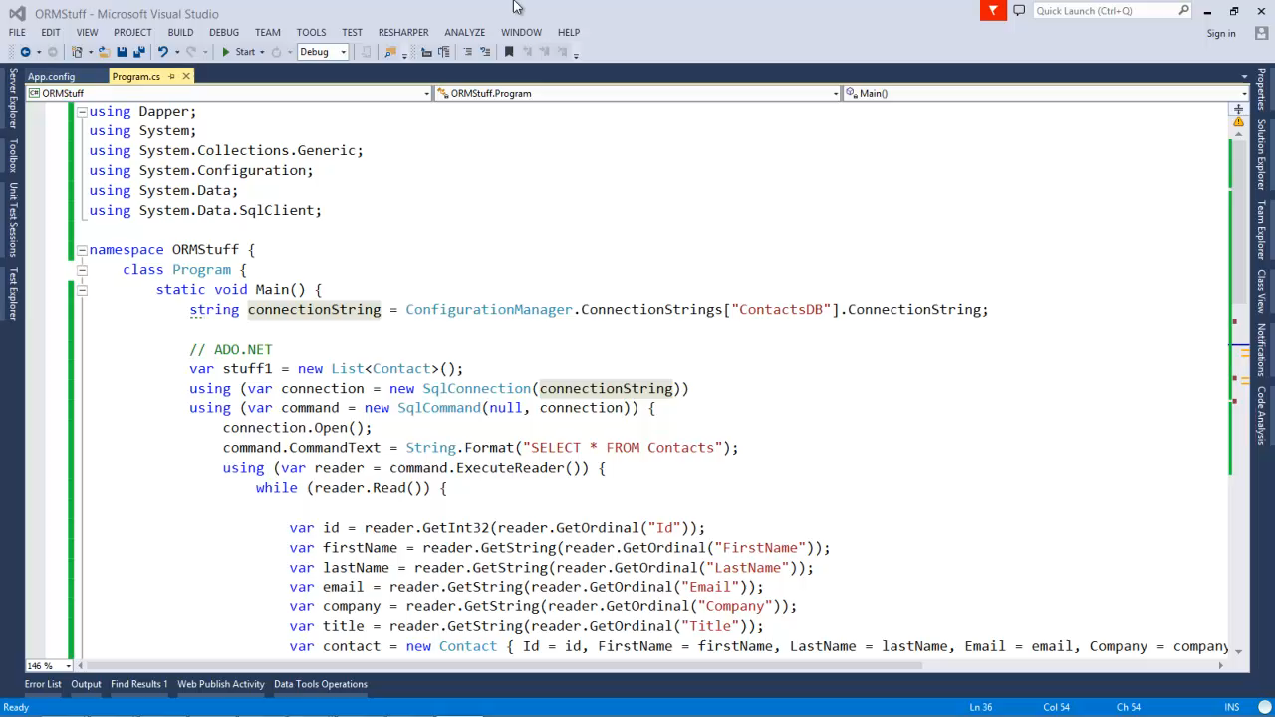
..

Slide 32
MVC5 – How to build the Complex page ☺

Slide 33
..

Slide 34
Deploying – MSDeploy and Appveyor

Slide 35
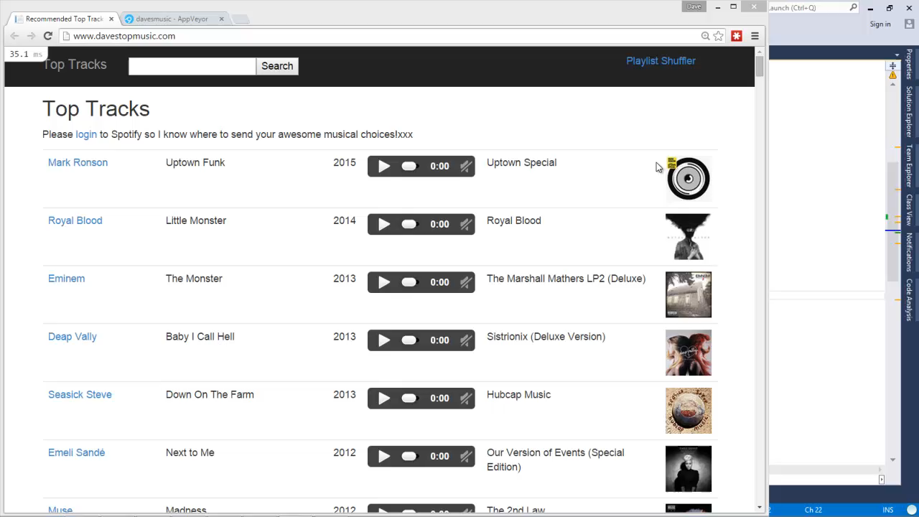
..

Slide 36
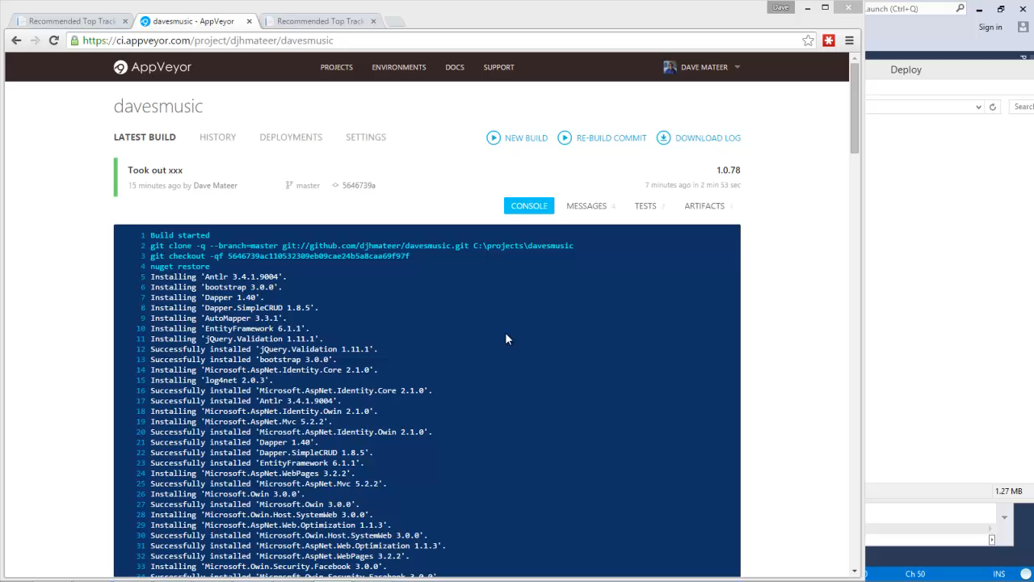
…

Slide 37
Music!
Suggestions for a
band or song to lookup? ☺
Notes:
What are your great songs of all time?
First record / single / tape / download you ever bought?
First gig?

Slide 38
Where to next?
This is a Spike
Notes:
Ordering of tracks in Spotify
Wrong track being linked (multiple versions of a track)
Date problem
User Stories revisit
Tags on songs?
I want to listen to disco
I want multi dtm playlists
Full rewrite - Clean code
TDD it
DI
Test WebClient
mock out API
Selenium style testing
Last.fm

Slide 39
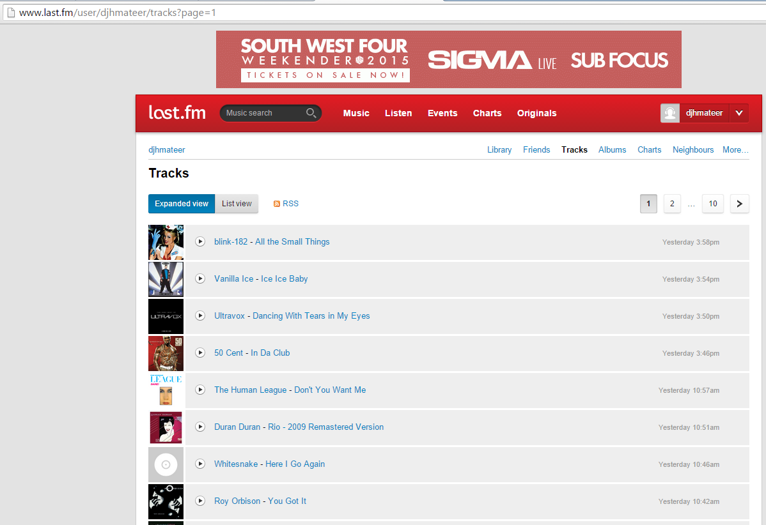
Where to next?
This is a Spike
Notes:
Full rewrite - Clean code
TDD it
DI
Test WebClient
mock out API
Selenium style testing

Slide 40
Summary
Embed Spotify in web pages
Console Apps to spike
Spotify Web API
ASP.NET MVC
Async
Dapper (ORM)
MiniProfiler
Deploying Appveyor
Azure and EC
Music that inspires you?
davemateer at gmail.com
github.com/djhmateer
www.davestopmusic.com

